Slide 1
Imaging Genetics with
Scientific Linux 6.4
Bennett Landman
Mary Ellen Koran
Tricia Thornton-Wells
January 20, 2014 version 1.0

Slide 2
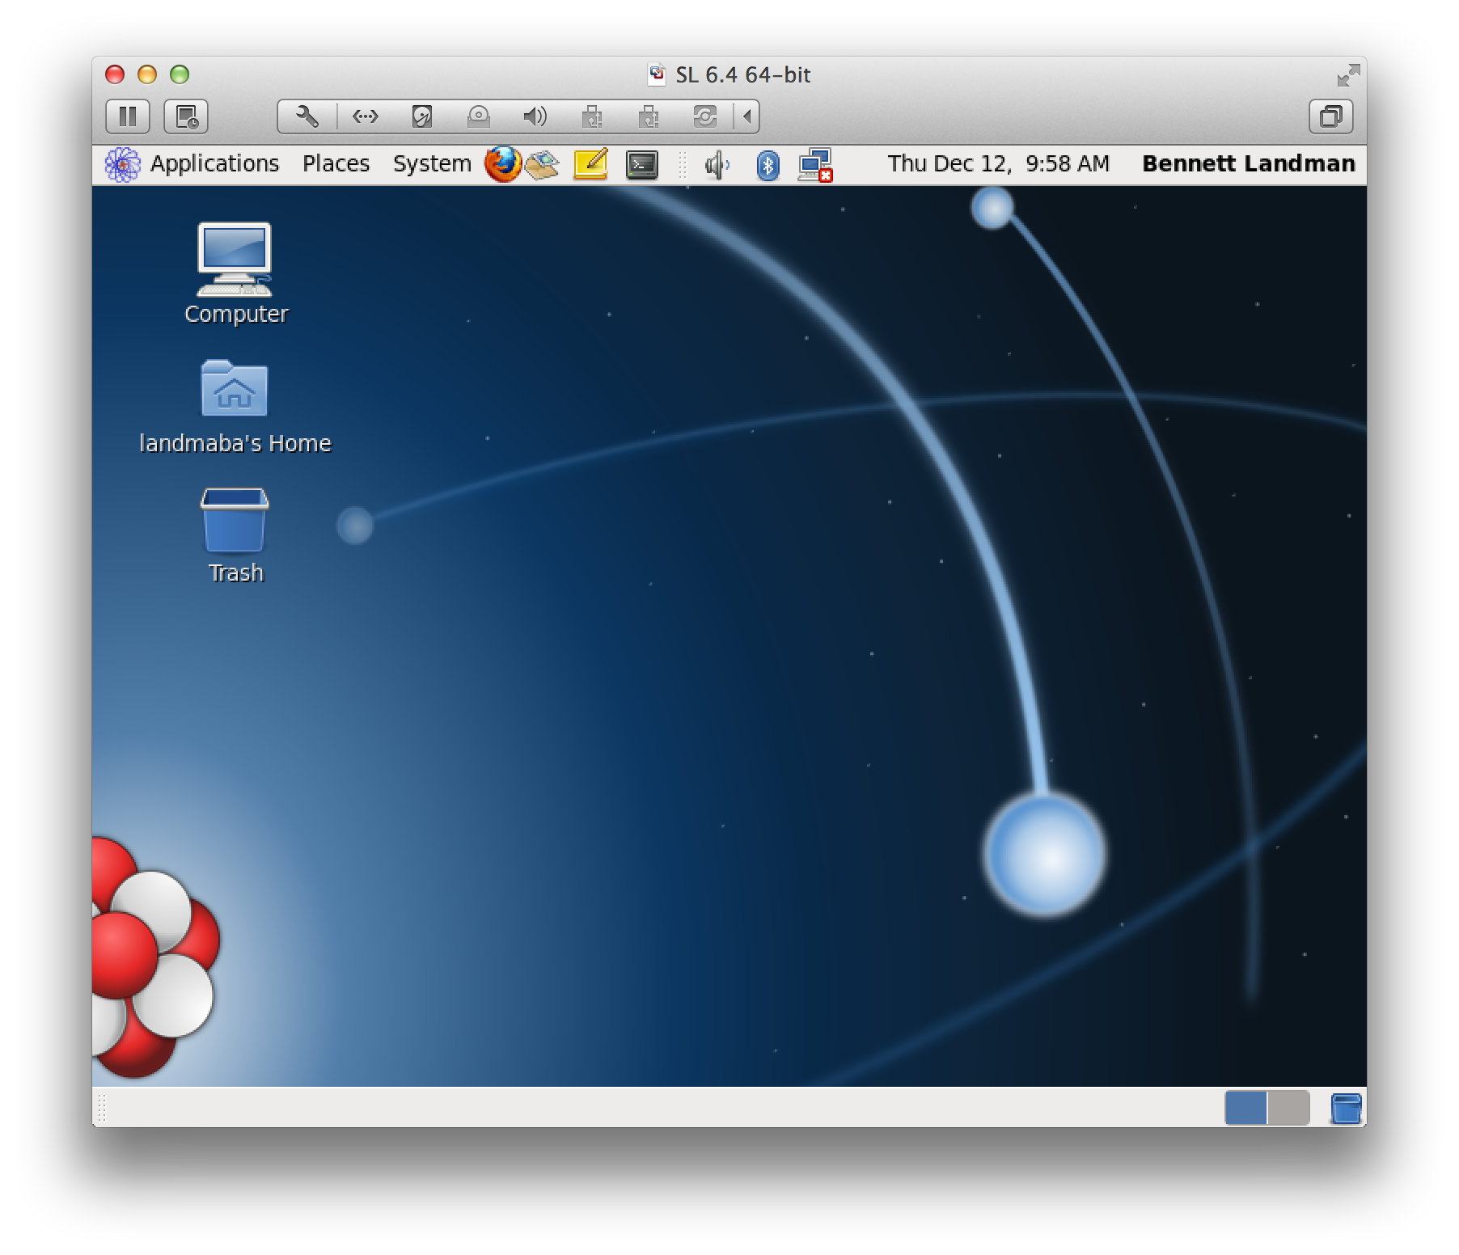
Log in. We are using SL 6.4 On VMWare Fusion 6

Slide 3
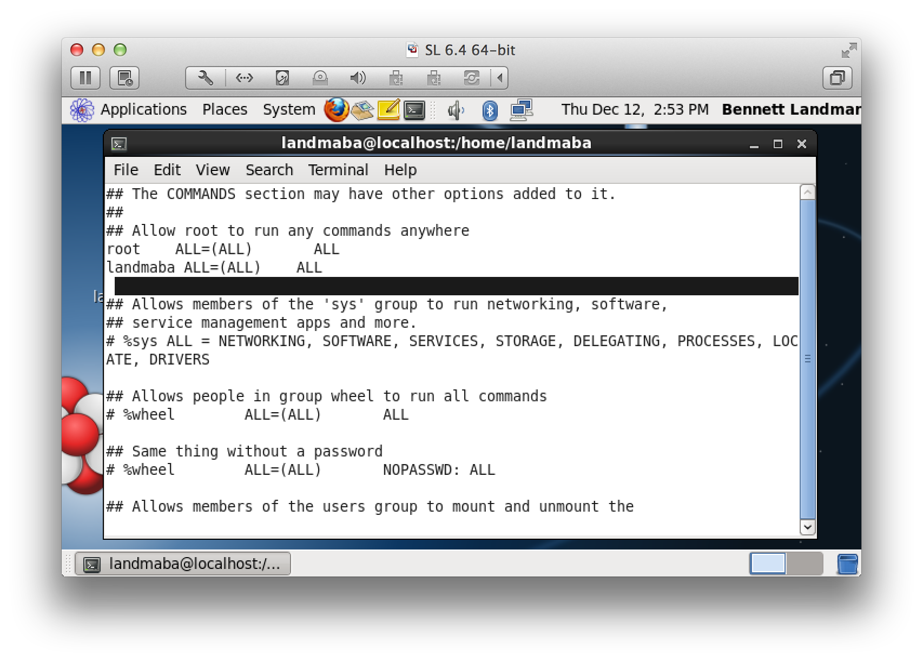
Add the local user to sudoers so that you don’t need to be root.
Use “su” then visudo.

Slide 4

Setting up SOLAR (with ECLISPE)
Part 1

Slide 5
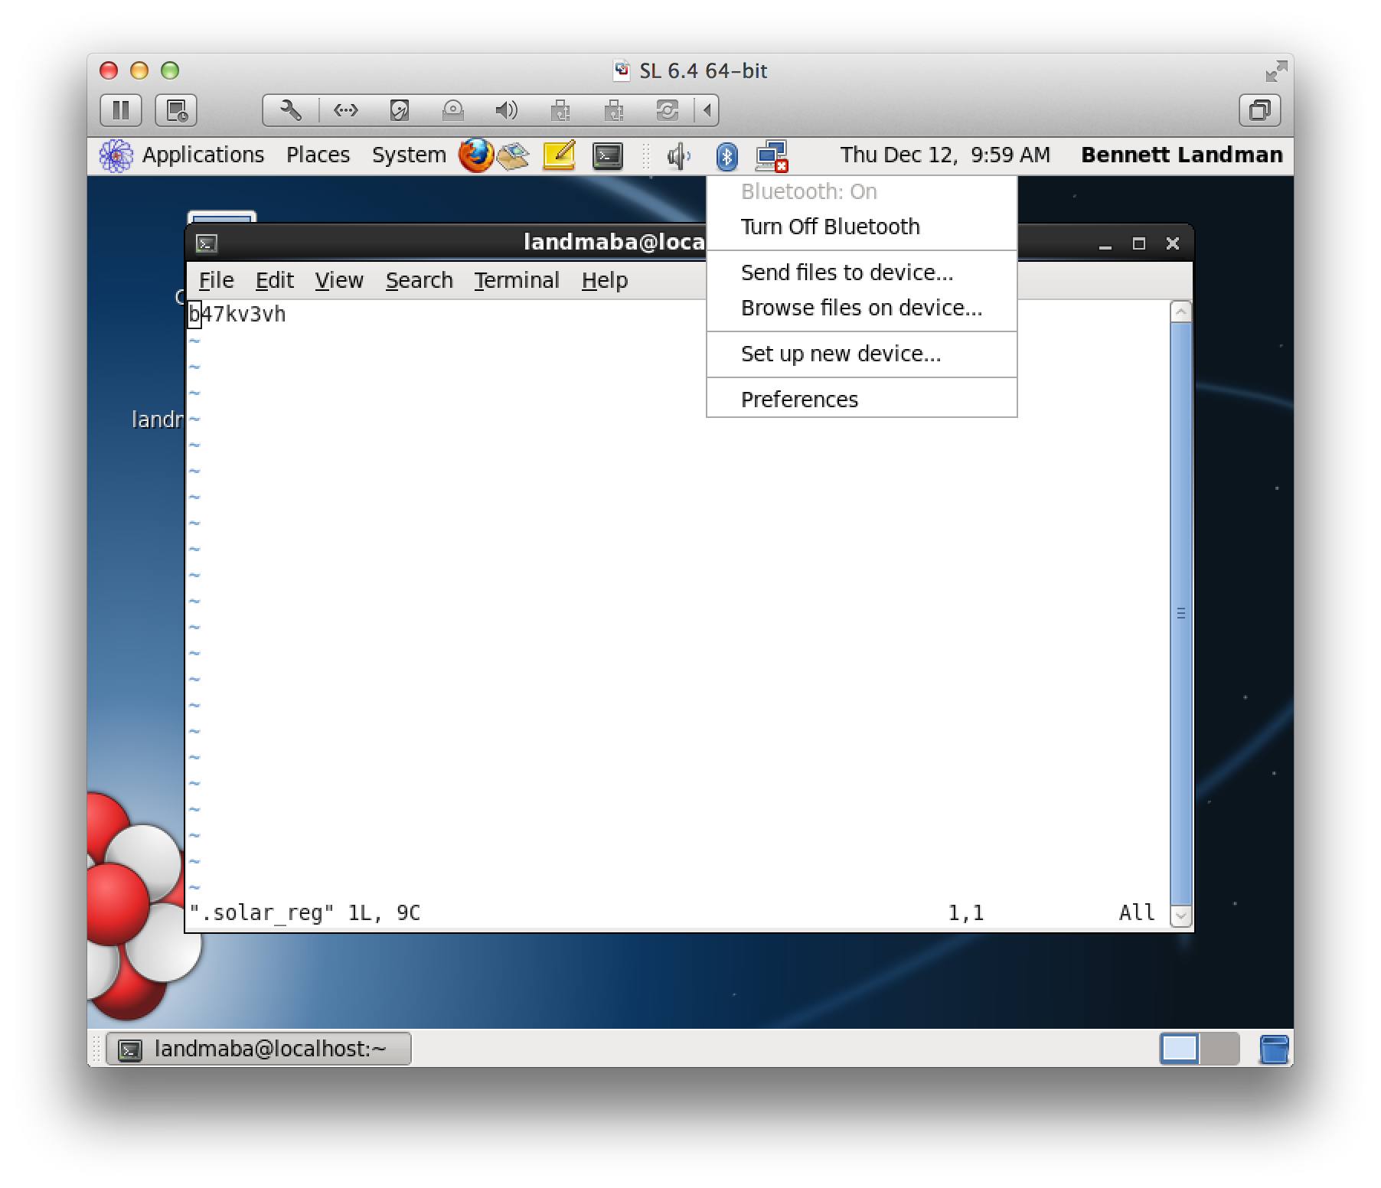
Edit ~/.solar_reg and type the key for your SOLAR user

Slide 6
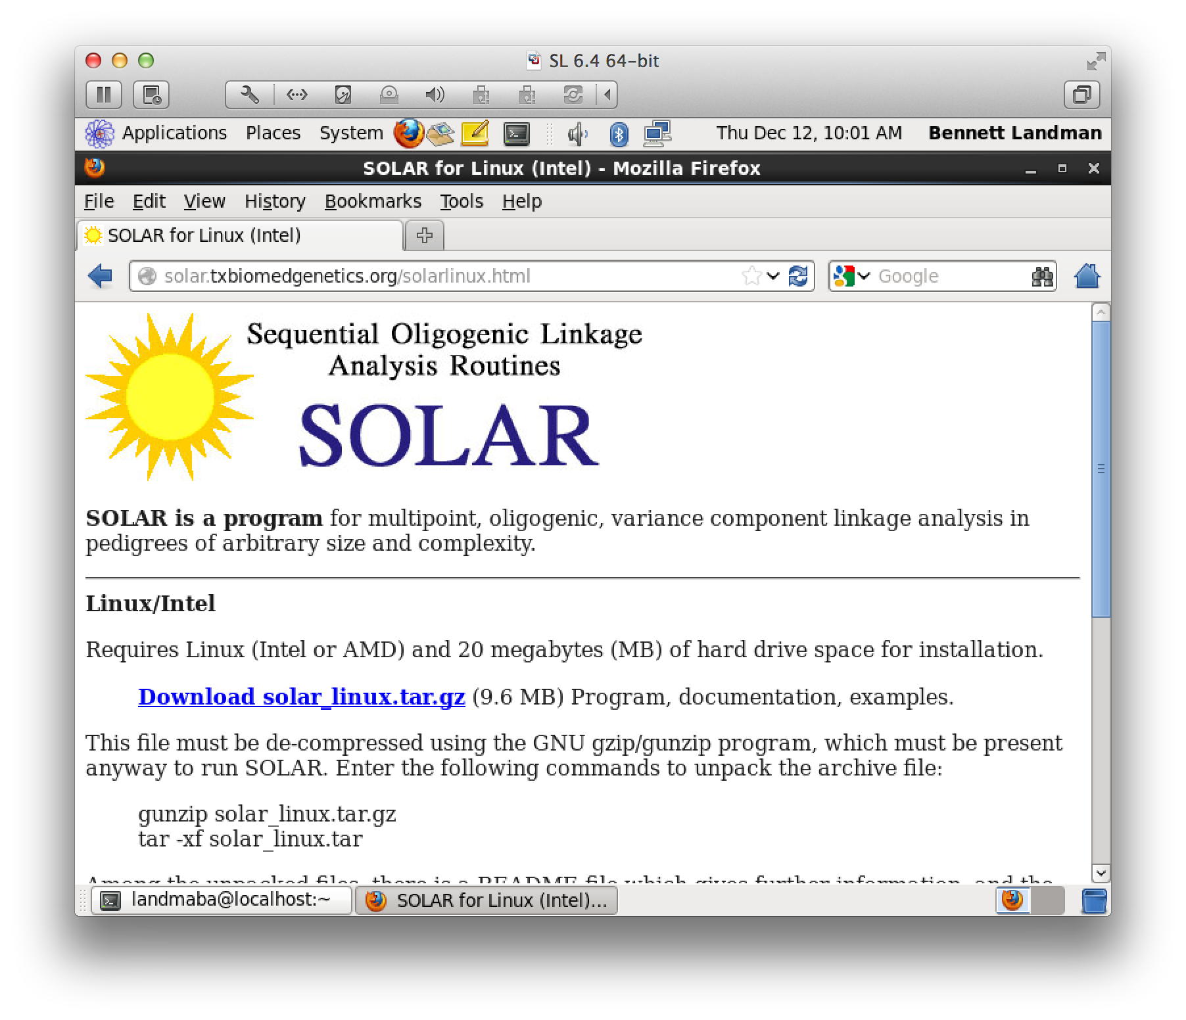
Go to the SOLAR website.

Slide 7
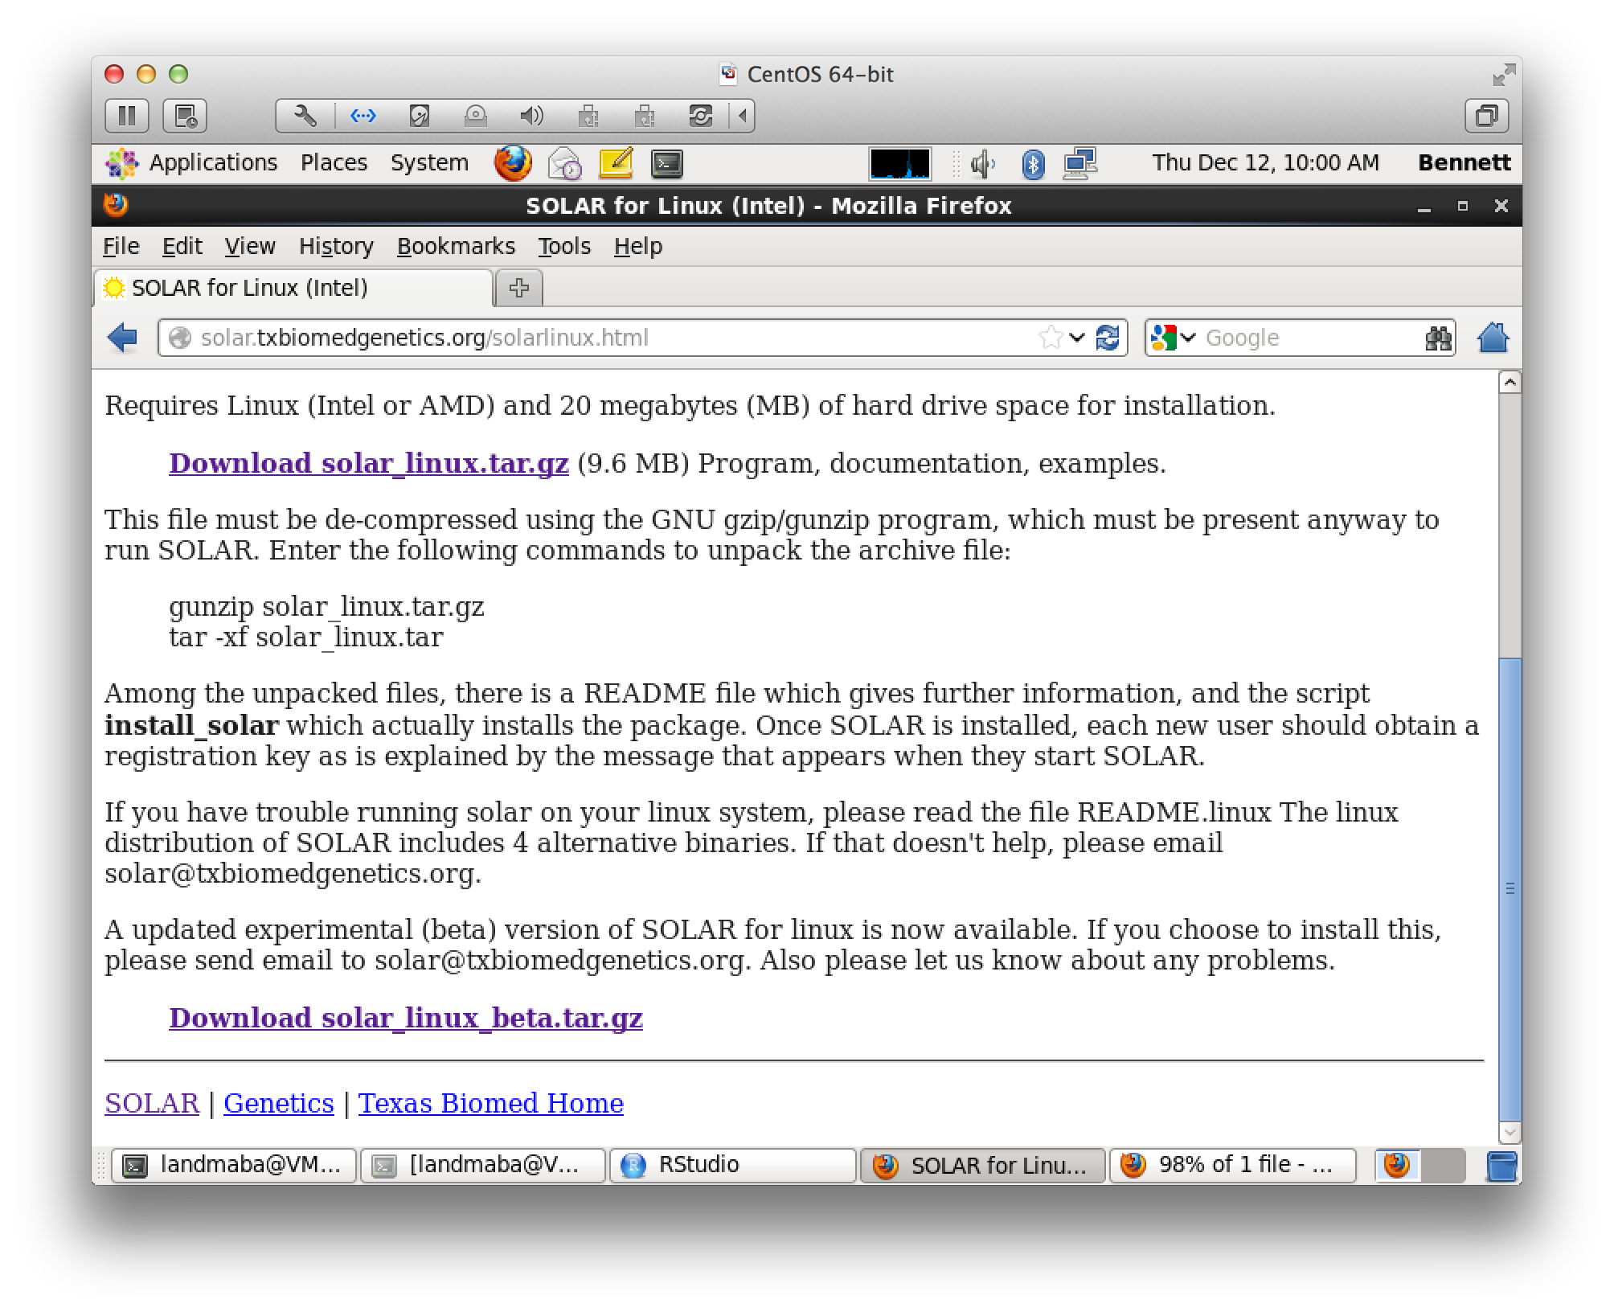
Download the most recent stable version of SOLAR. We are using the October 2013 release.

Slide 8
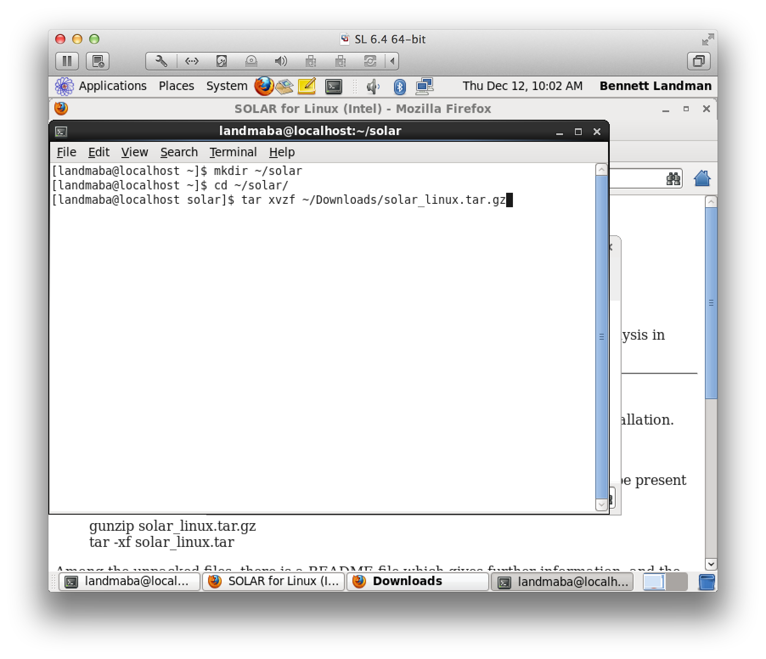
Create a directory for solar. We are using ~/solar. Unpack the download.

Slide 9
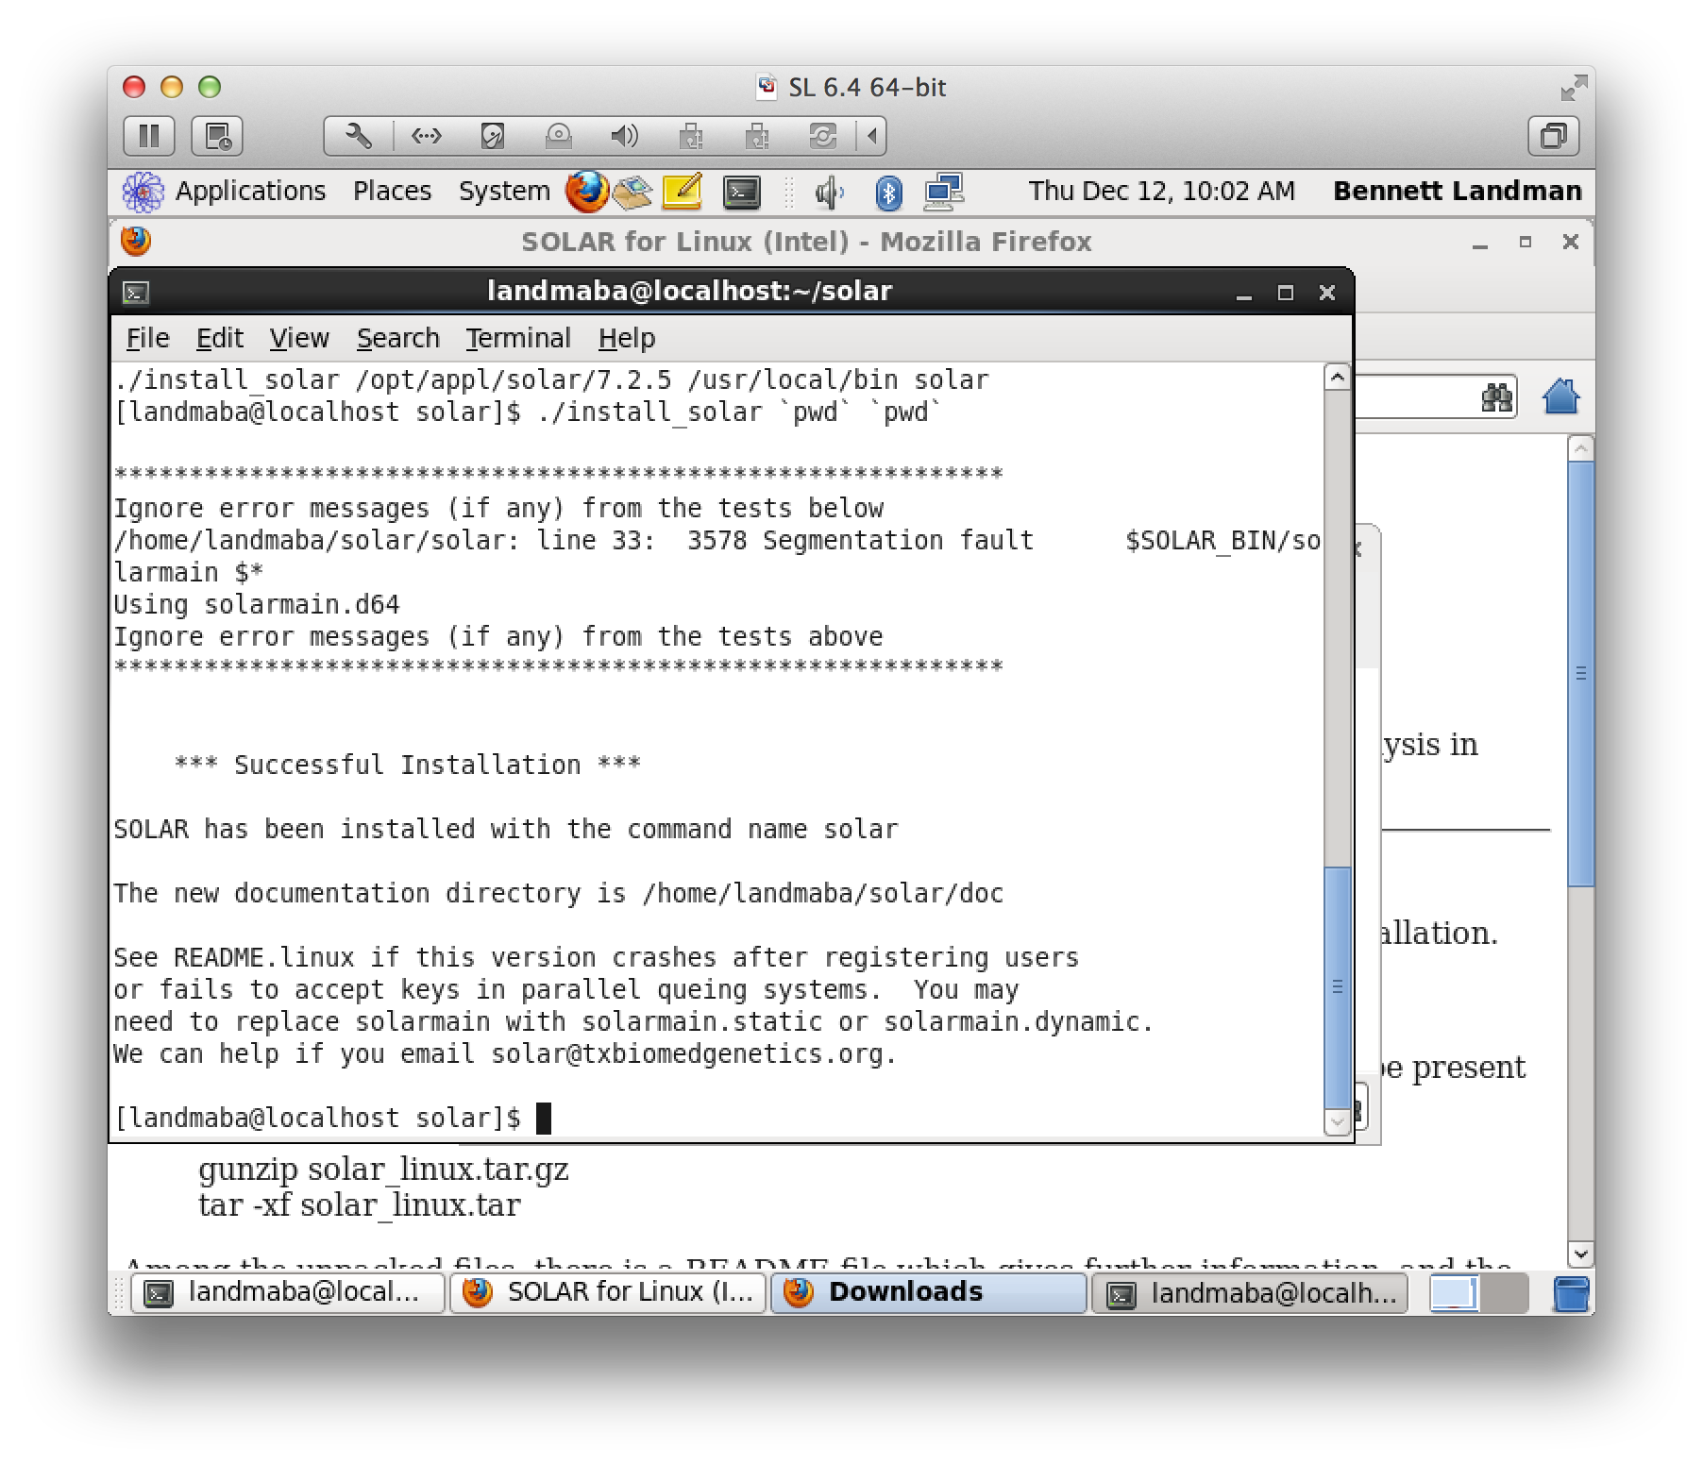
Install it: ./install_solar `pwd` `pwd`

Slide 10
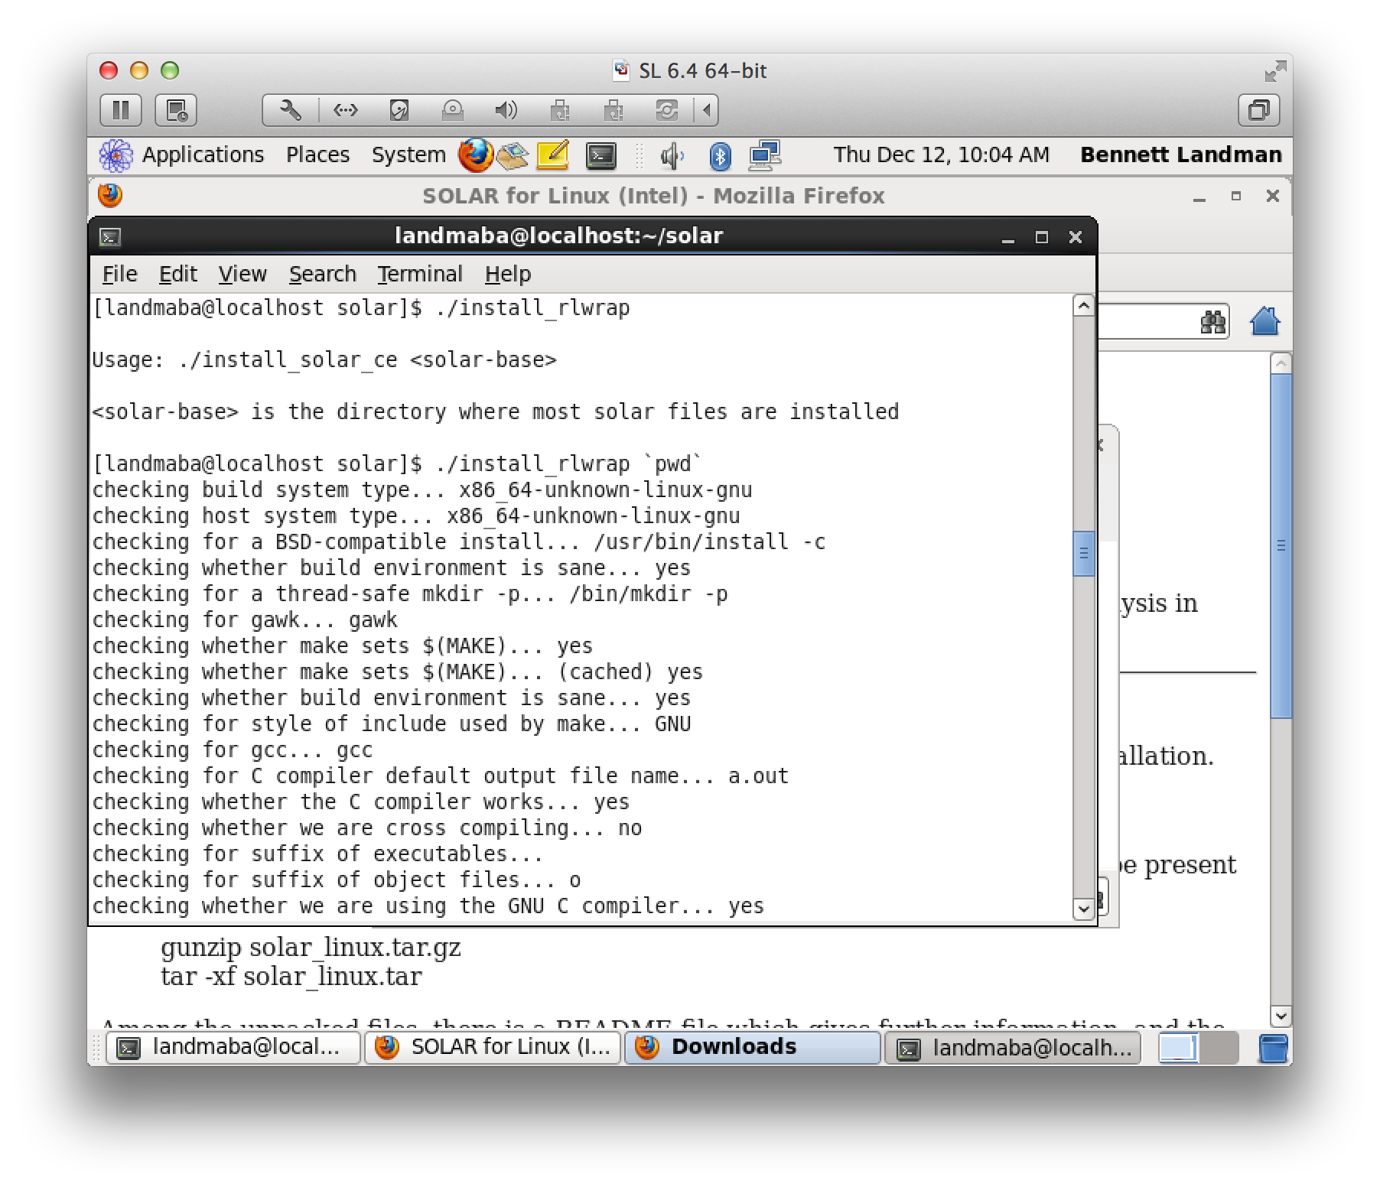
Install rlwrap: ./install_rlwrap

Slide 11
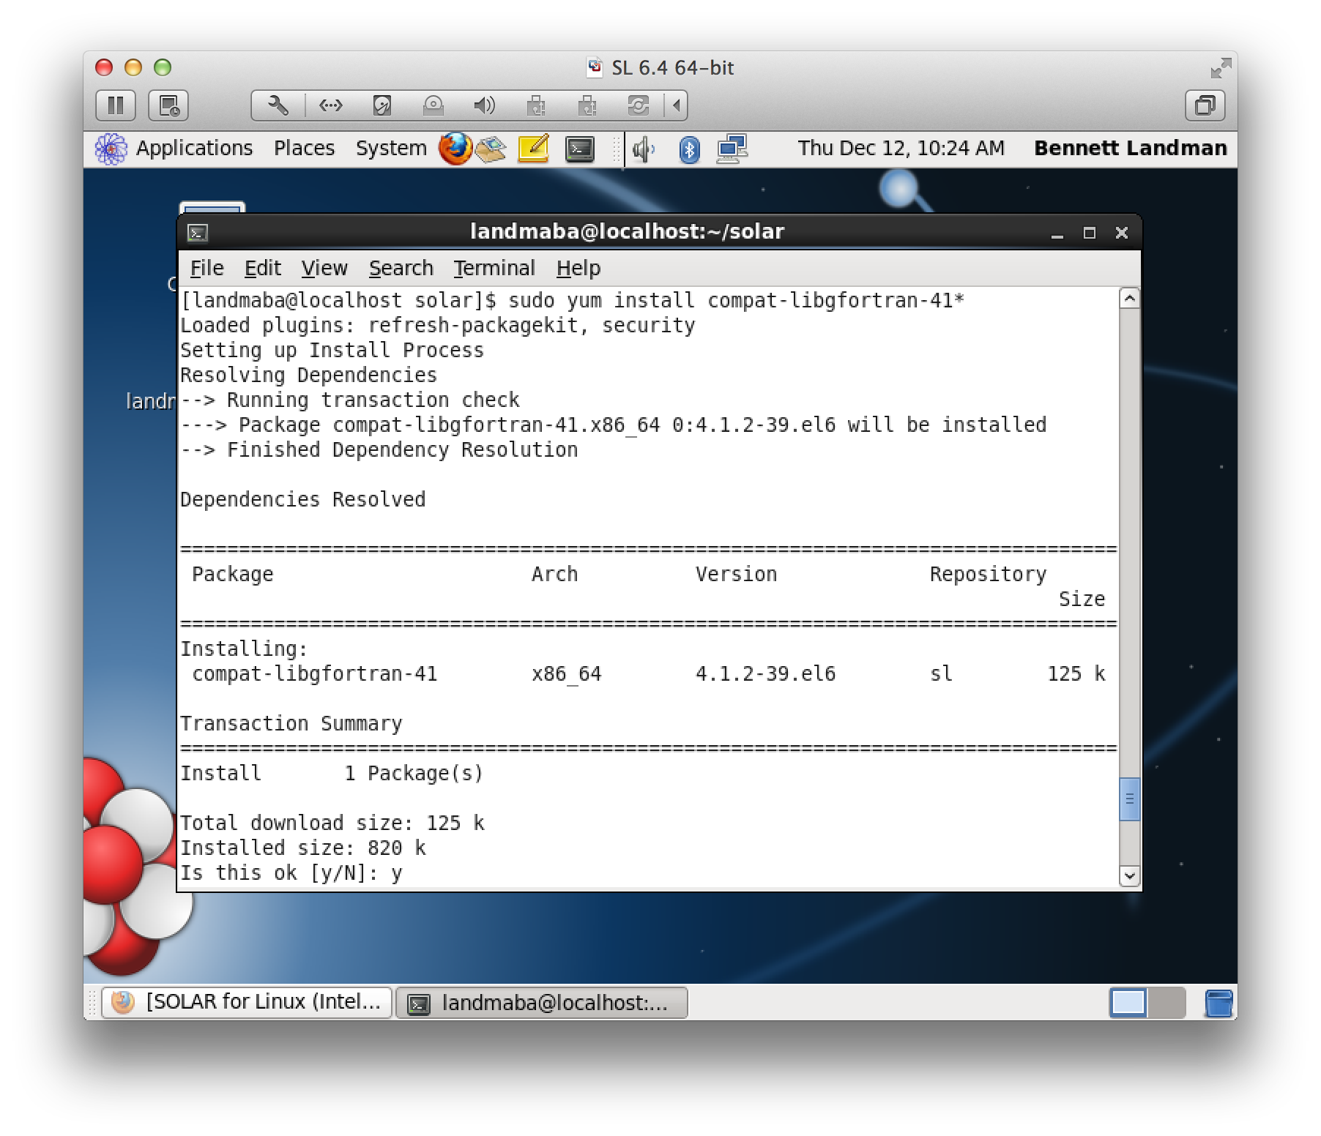
Install the libgfortran.so.1 library (not included by default).

Slide 12
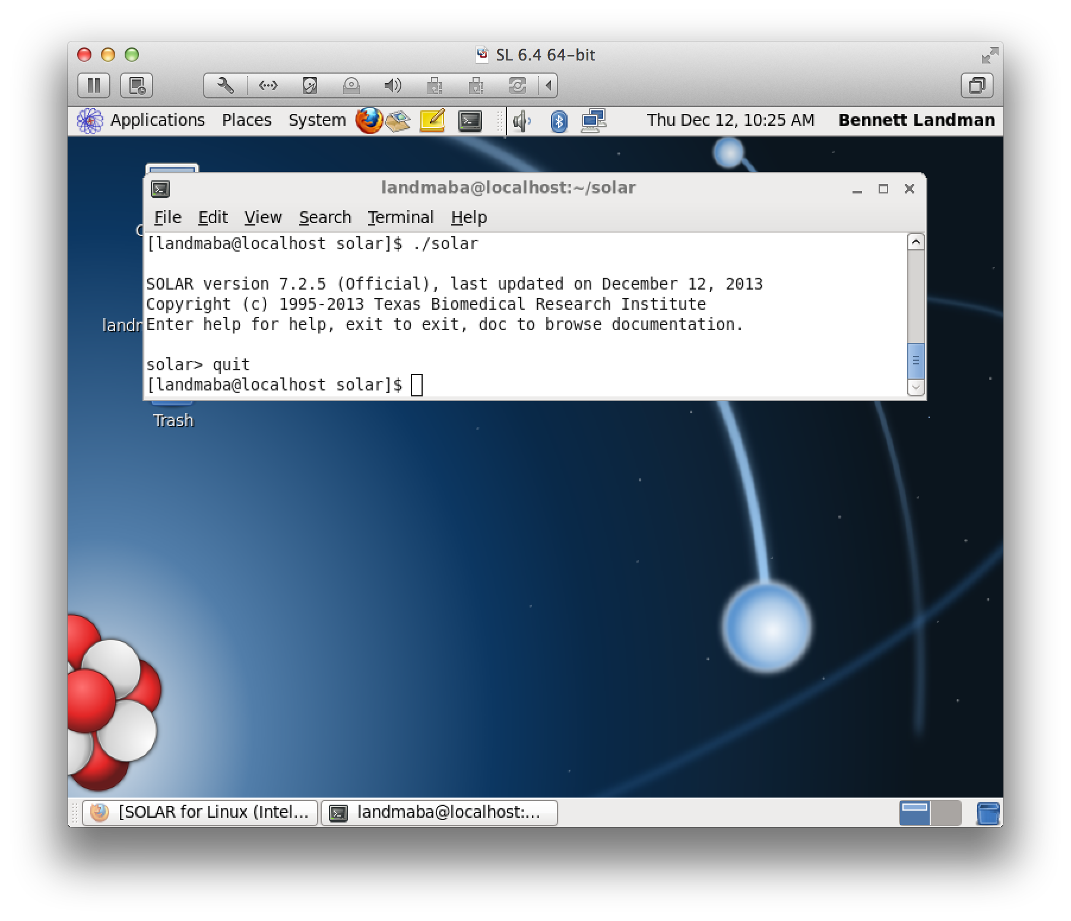
Make sure that solar starts without core dumping.

Slide 13

Aside: If you are using CENTOS 6.5 or Ubuntu 12.04 LTS (or other recent Linux)
Copy libgfortran.so.1 to the solar/lib directory.
Here is a copy that we pulled from Scientific Linux 6.4 64 bit:
https://masi.vuse.vanderbilt.edu/index.php/File:Libgfortran.so.1.zip

Slide 14
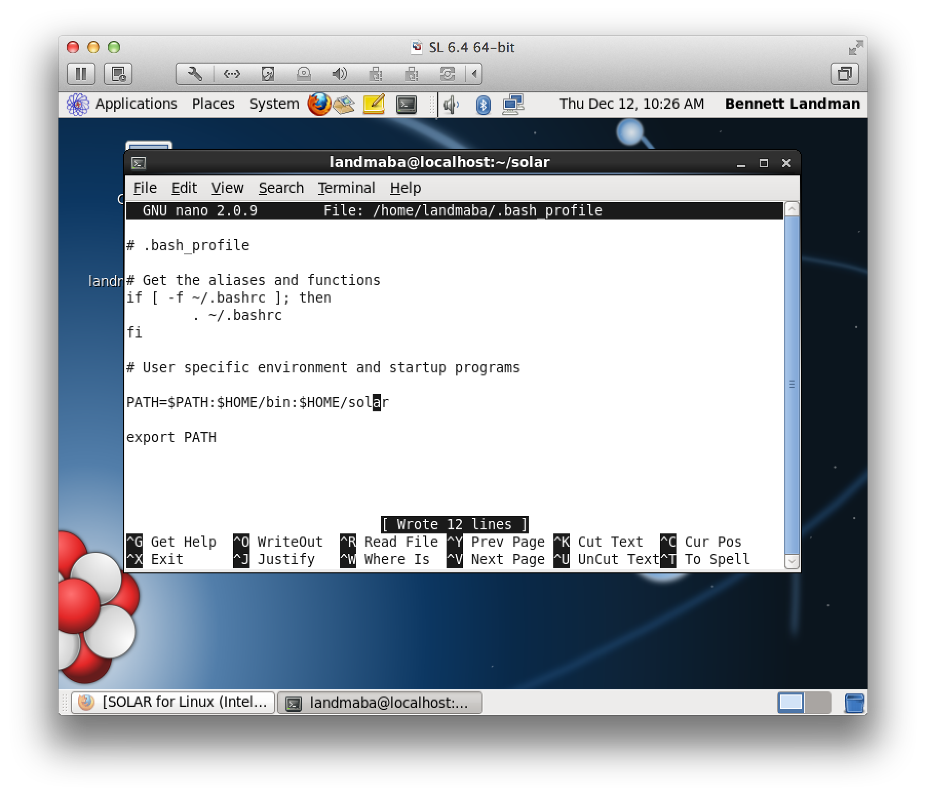
Add the solar directory to your path

Slide 15
Setting up OpenMX (with R and Rstudio)
Part 2

Slide 16
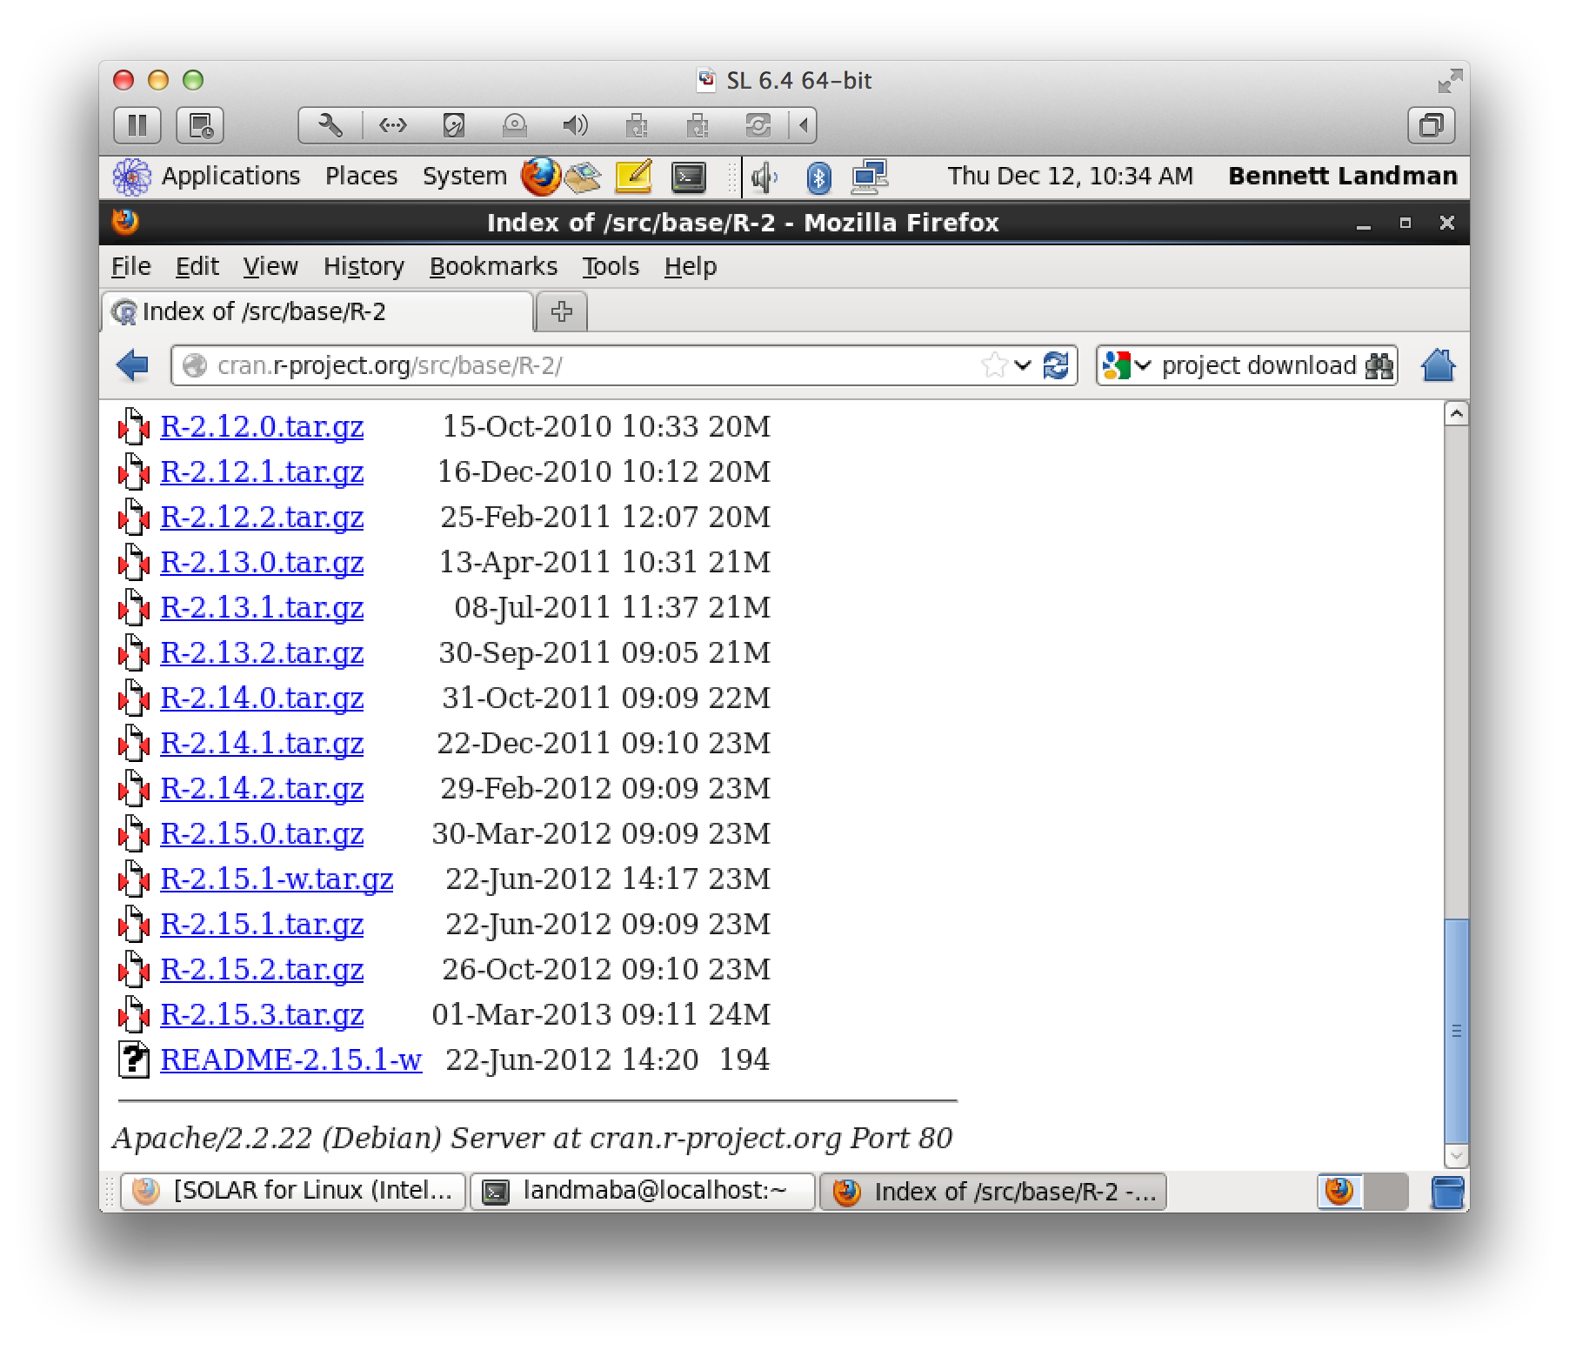
Download the source for R 2.15.3 (NOT 3.X.X)

Slide 17
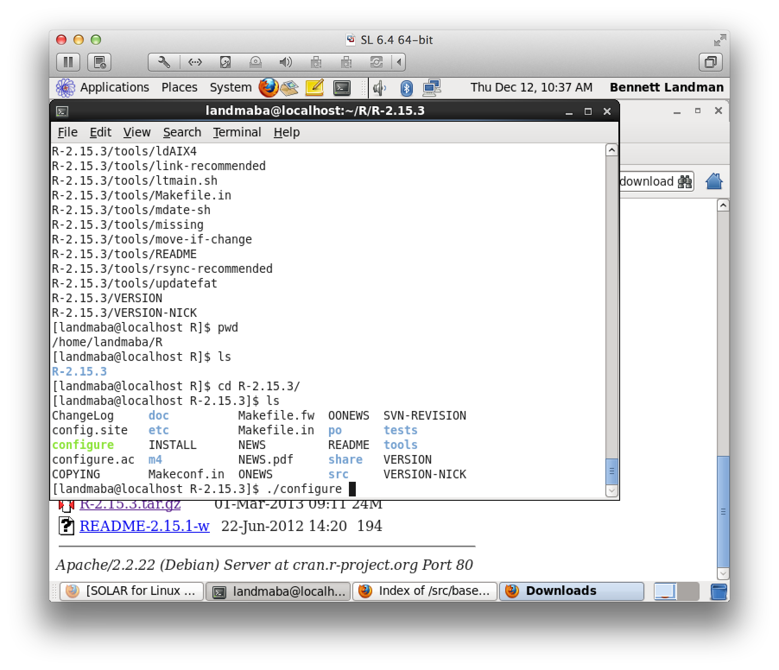
Make a directory for R. We are using ~/R. Unpack the download.

Slide 18
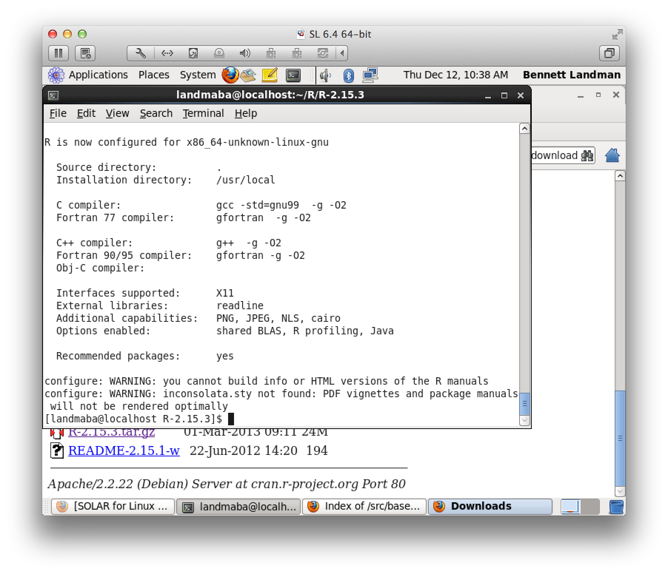
Run ‘sudo ./configure –enable-R-shlib’
We are not worried about building HTML manuals.

Slide 19
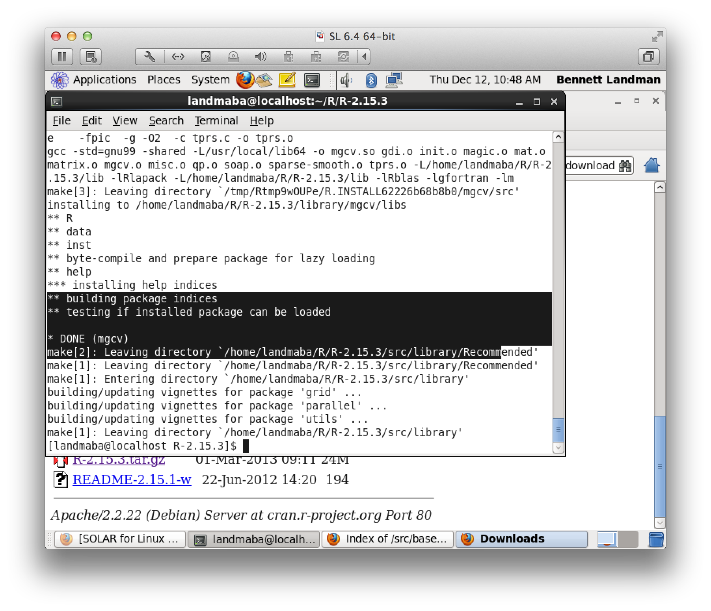
Run ‘sudo make ’

Slide 20
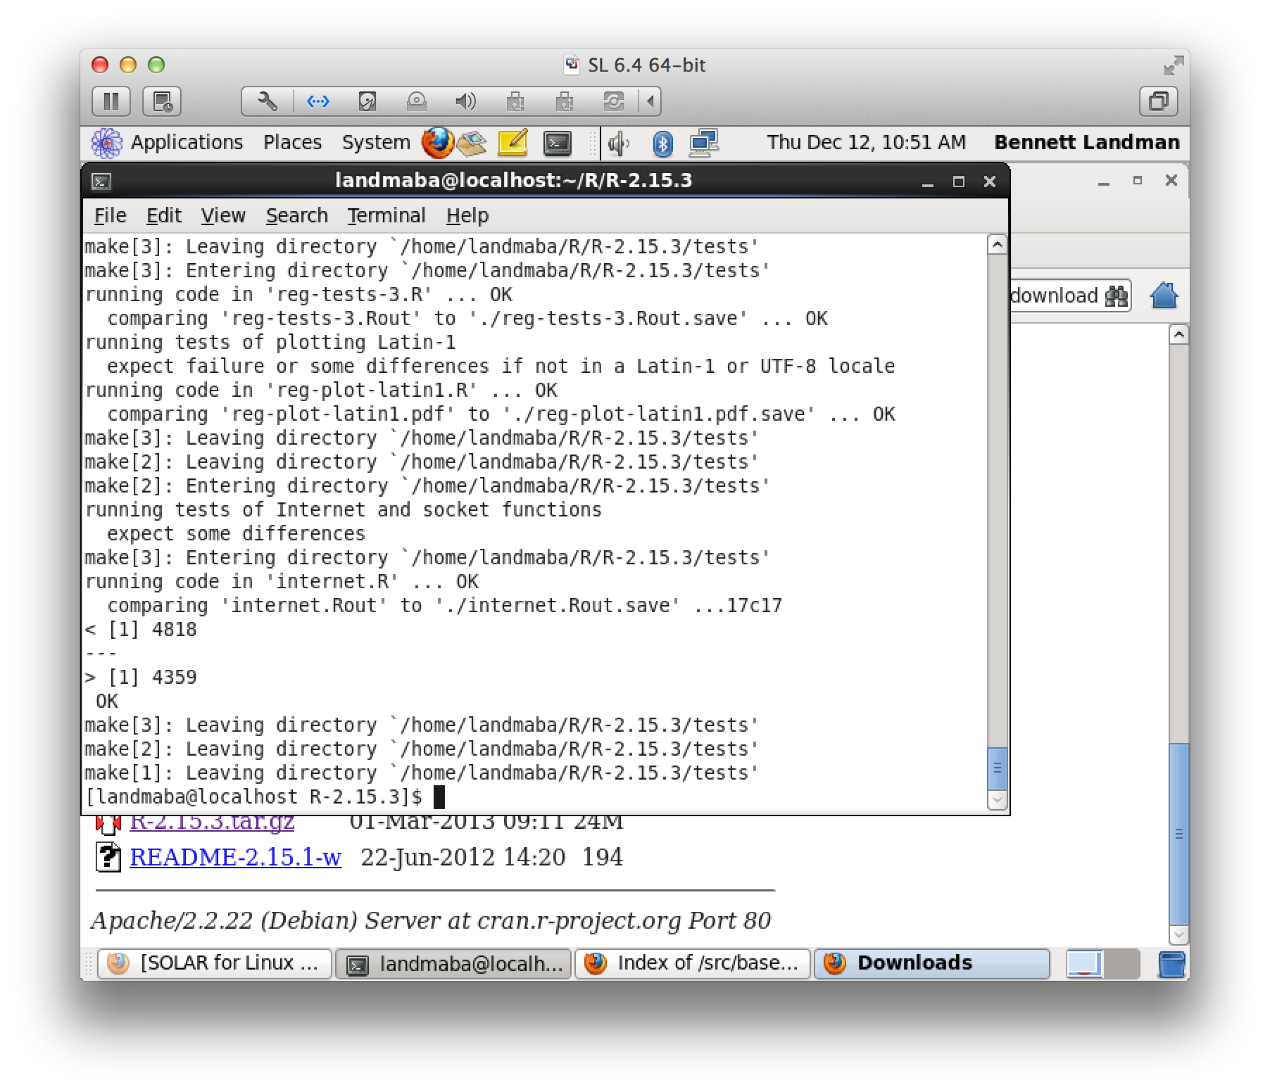
Run ‘make check’
Verify that there are no errors.

Slide 21
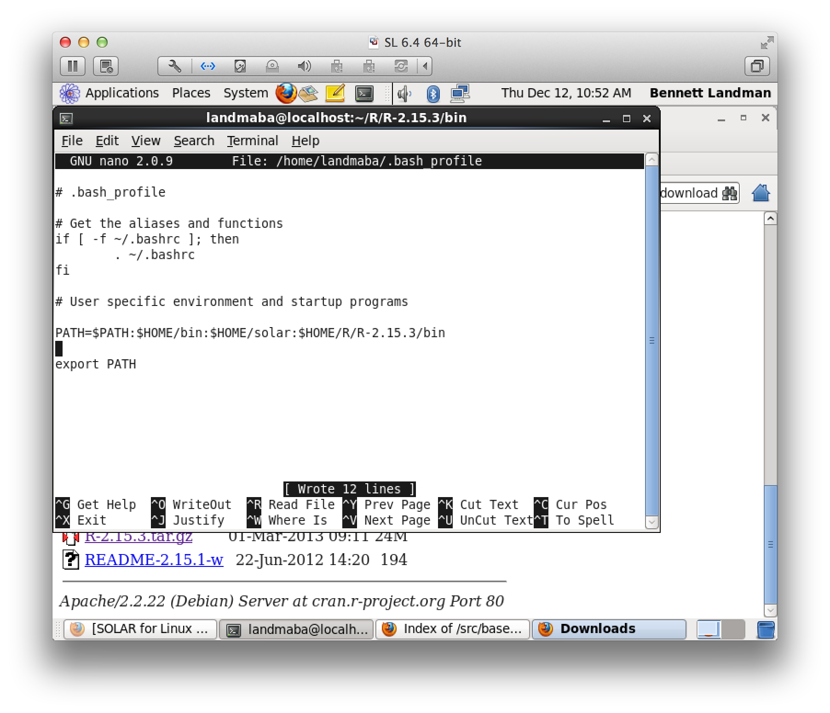
Add R’s bin directory to your path

Slide 22
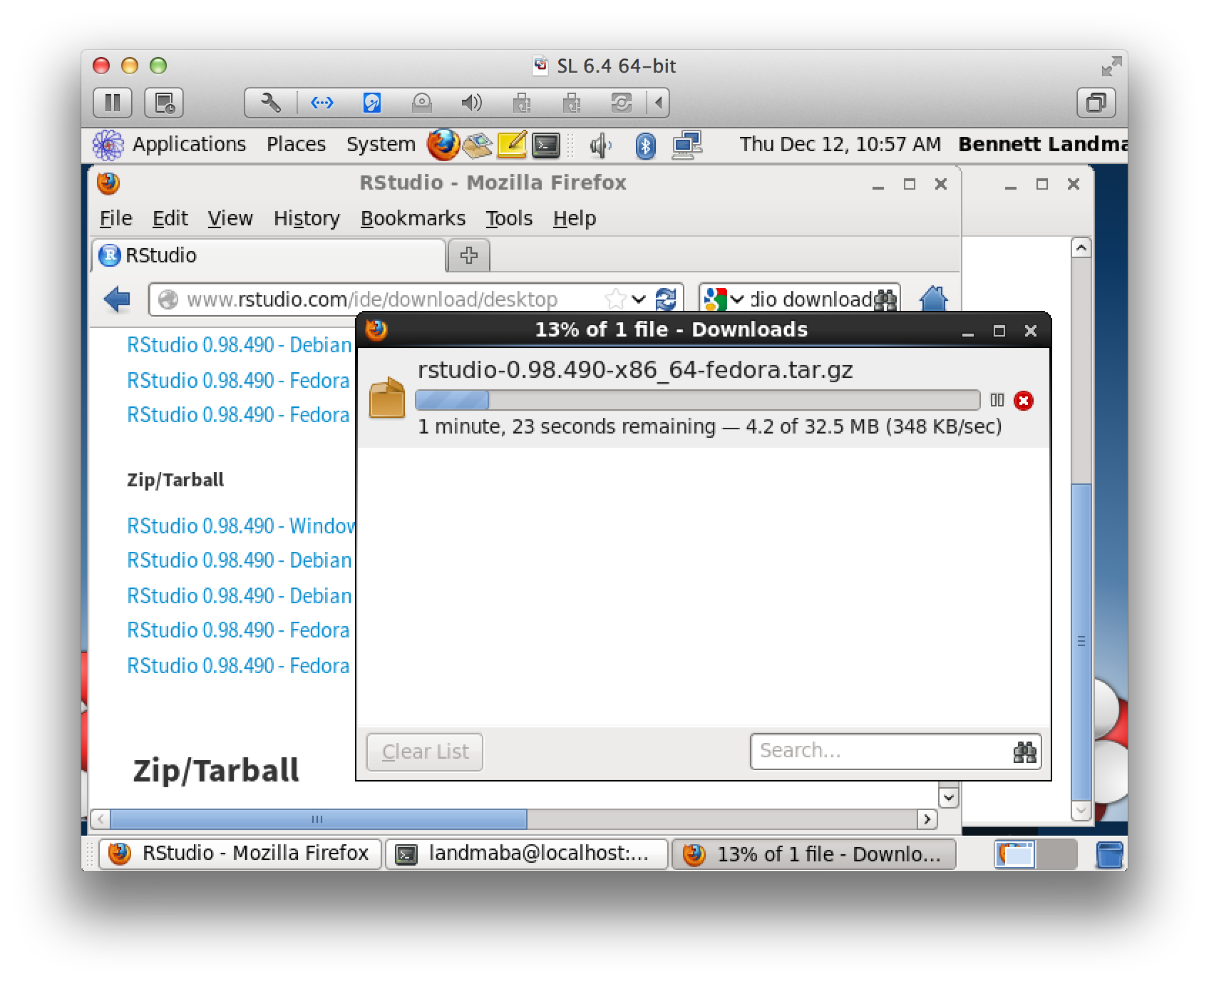
Log out. Log in.
Download R studio (without installer)

Slide 23
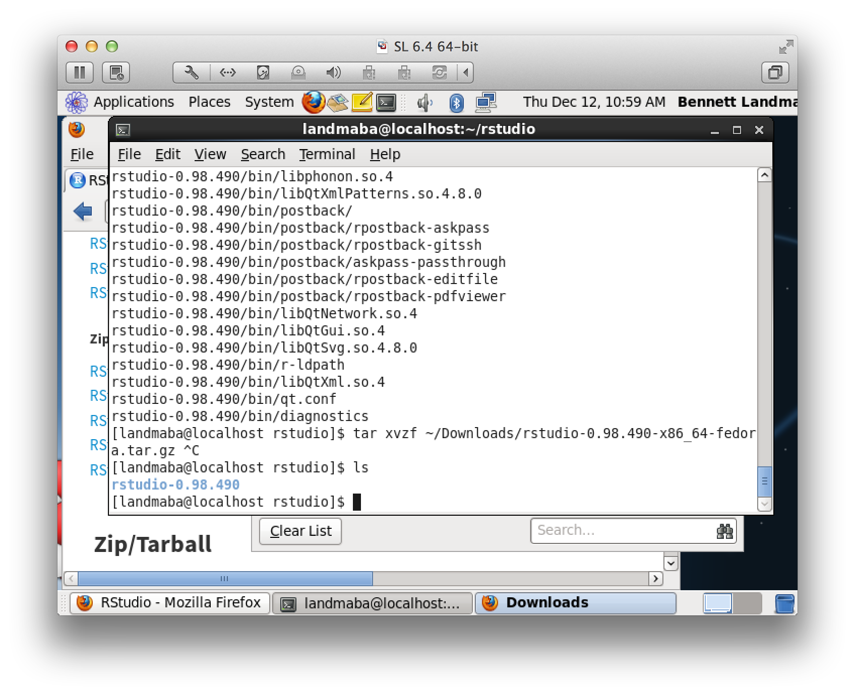
Make a directory for R studio and unpack the tar.gz tar xvzf ~/Downloads/rstudio-0.98.490-x86_64-fedora.tar.gz

Slide 24
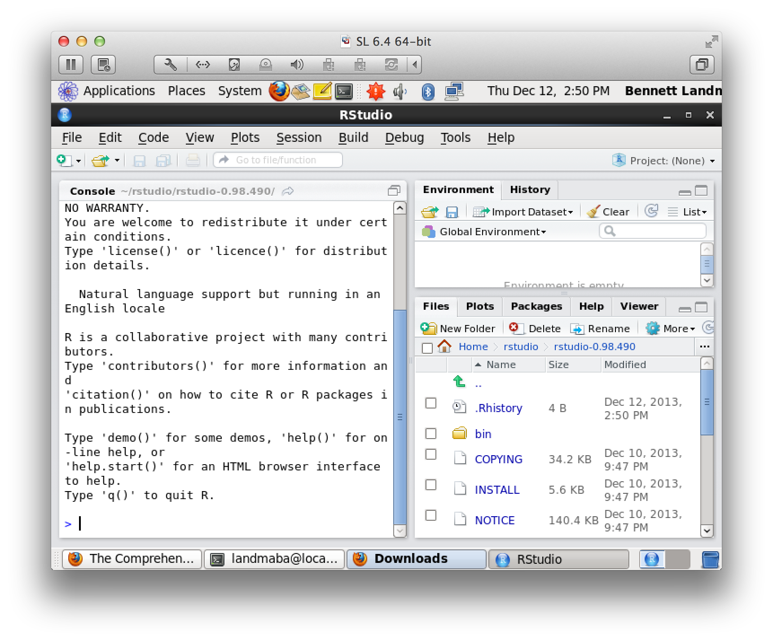
Test by running ./rstudio

Slide 25
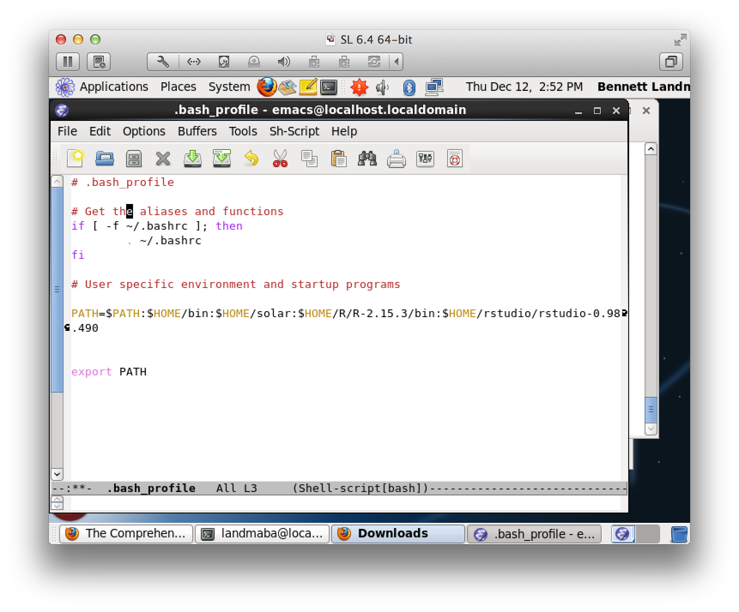
Add rstudio/bin to your path

Slide 26
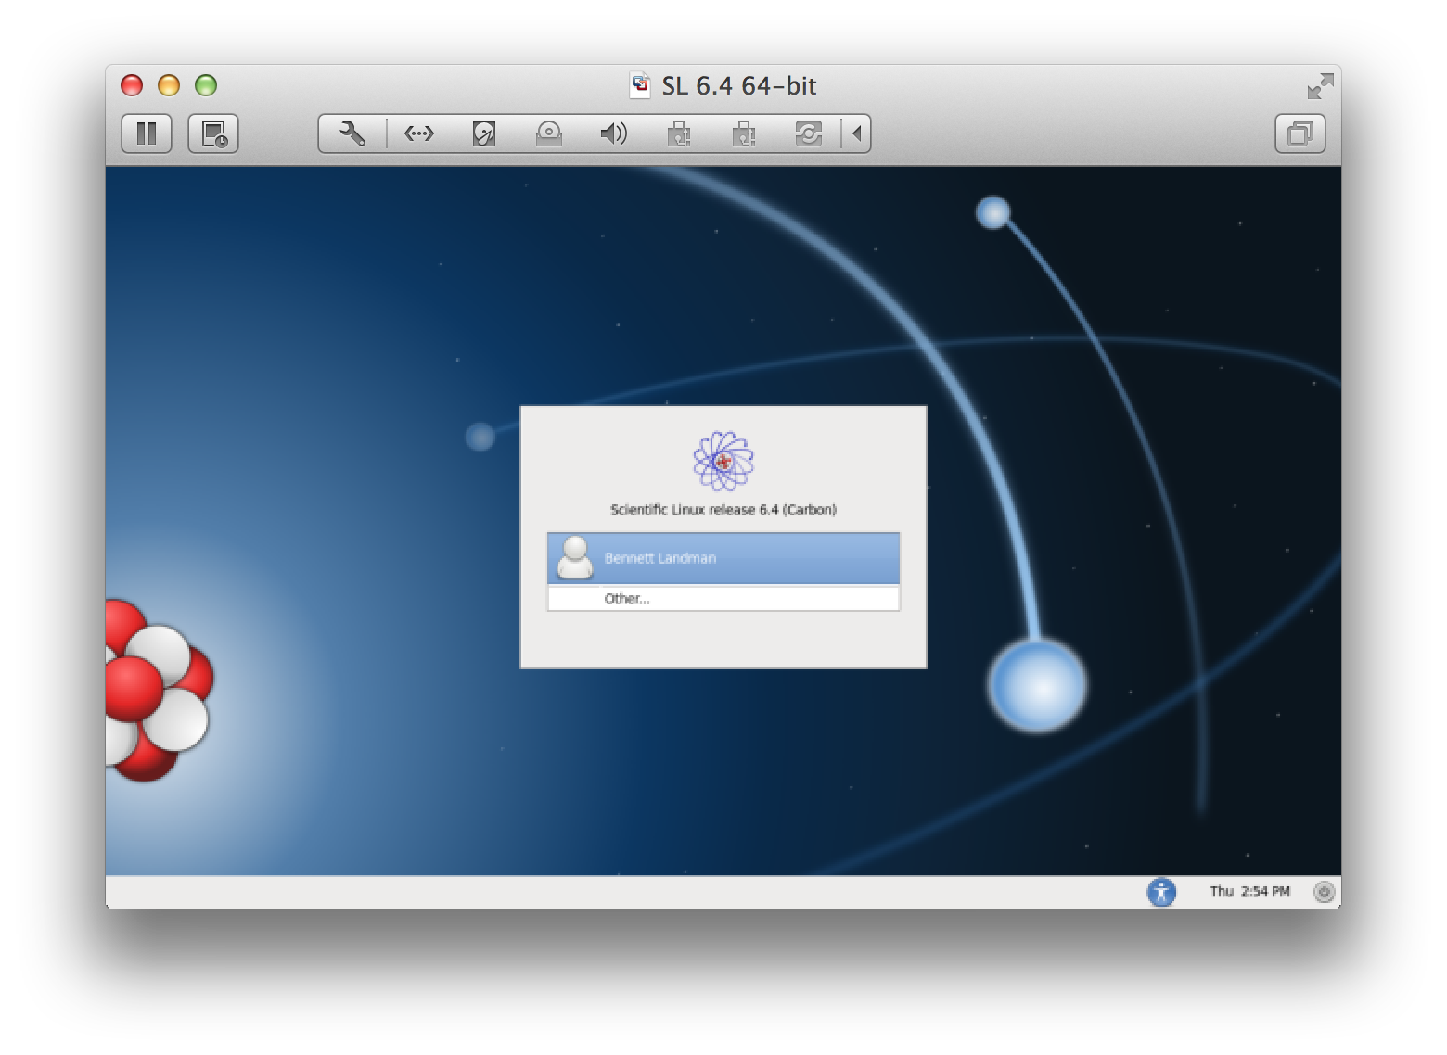
Log out and log in to complete the install process.

Slide 27
Running SOLAR and OpenMX with Simulated Data (for ACE models)
Part 3

Slide 28
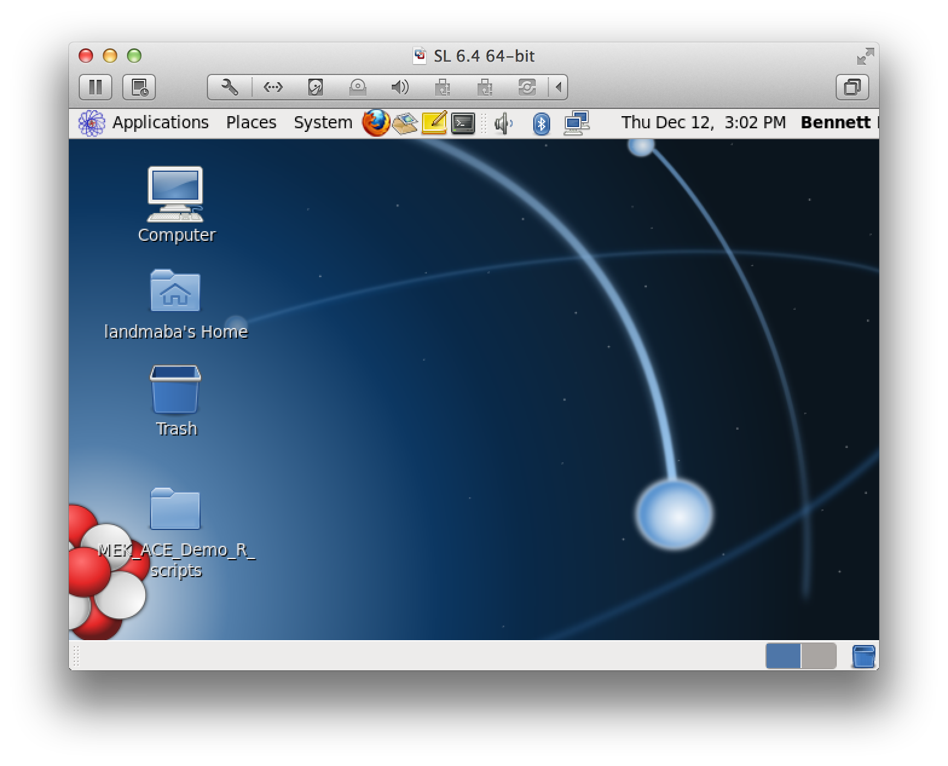
Download the example scripts.
~/Desktop/MEK_ACE_Demo_R_Scripts

Slide 29
Install R package g-plots on the command line (needed for 2.15 support)
curl -O http://cran.ma.imperial.ac.uk/src/contrib/Archive/gplots/gplots_2.6.0.tar.gz
tar xzf gplots_2.6.0.tar.gz
cat <<EOF > /tmp/inst.sh
options(repos=structure(c(CRAN="http://cran.ma.imperial.ac.uk")))
install.packages("gtools")
install.packages("gdata")
install.packages("gplots", repos = NULL, type="source")
EOF
Rscript /tmp/inst.sh

Slide 30
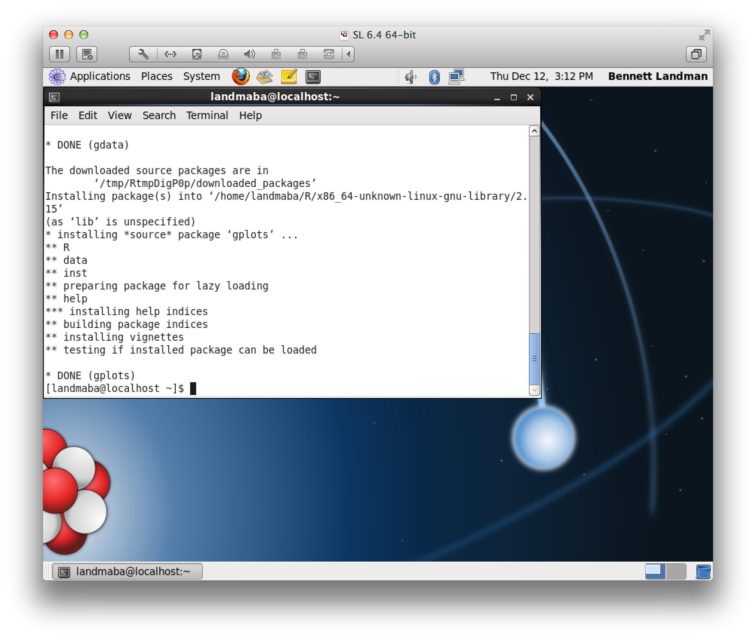
Gplots installed

Slide 31
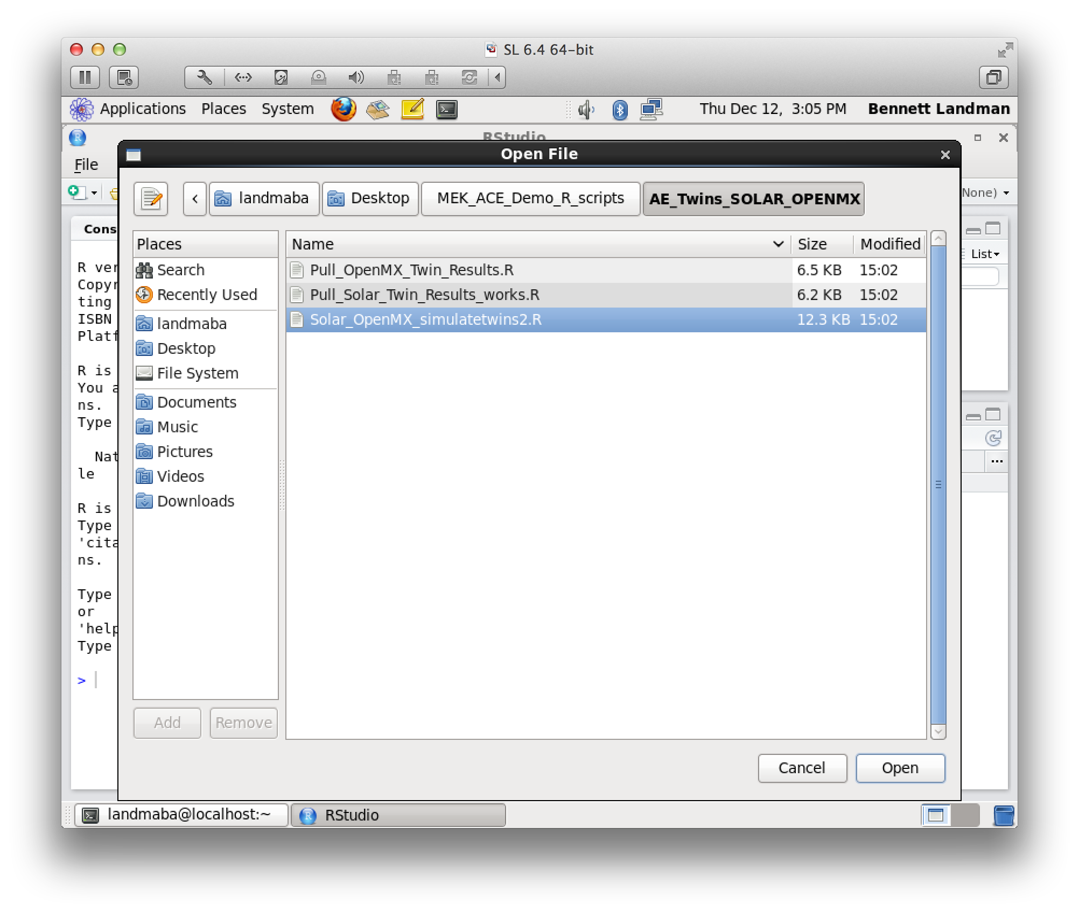
Open R studio and open the first file.

Slide 32
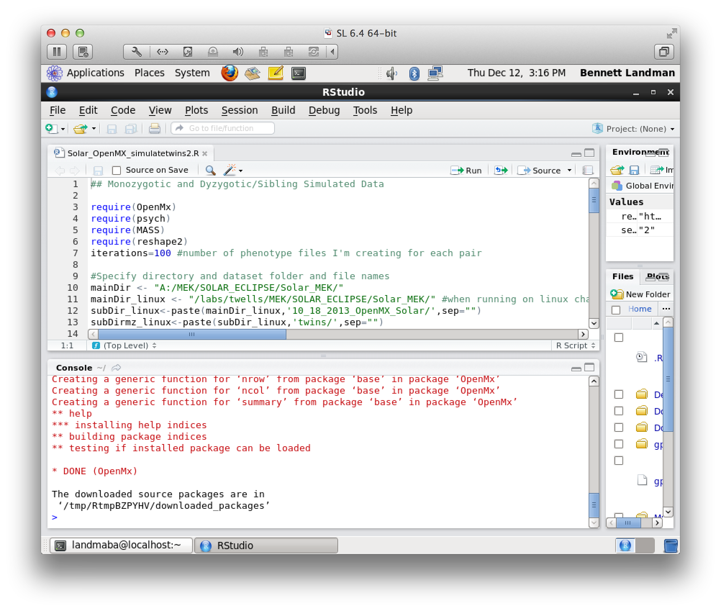
Install OpenMX in R with: source('http://openmx.psyc.virginia.edu/getOpenMx.R')

Slide 33
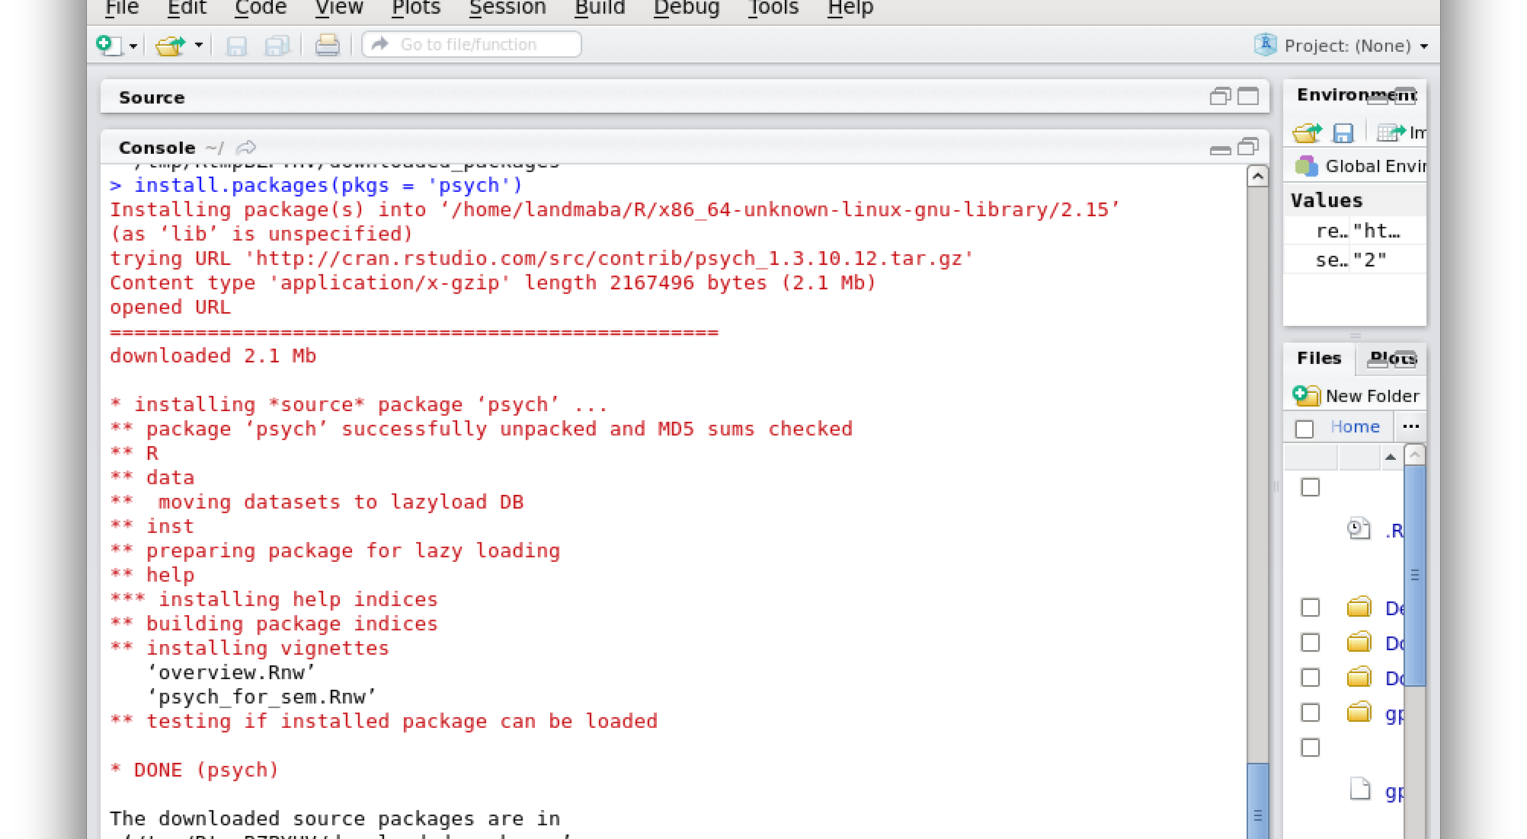
Install package psych install.packages(pkgs = ‘psych’)

Slide 34
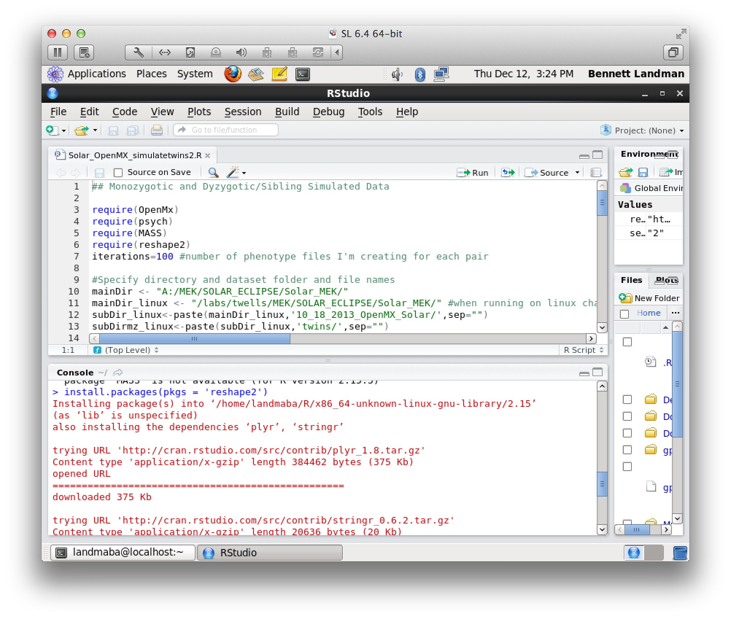
Install package reshape2 install.packages(pkgs = ‘reshape2’)

Slide 35
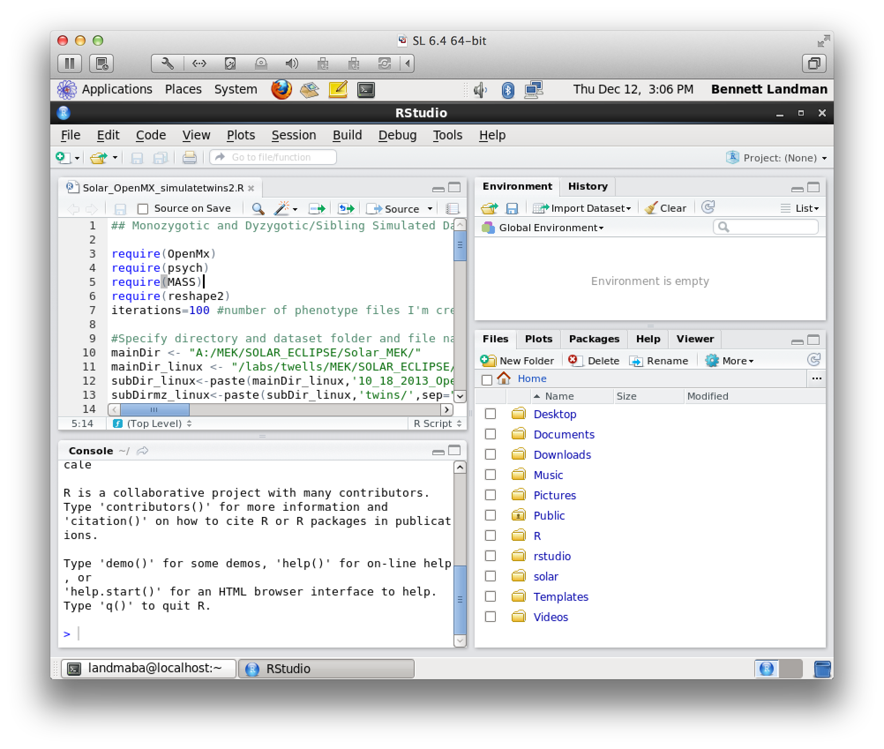
You can browse the code and run line by line with the editor.

Slide 36
WARNING
Running Step 1 (R simulation and OpenMX) takes about 12 hours*.
Running Step 2 (SOLAR commands) takes about
Running Step 3 (aggregating and graphing results) takes about
* on a single core of a 2.9 GHz i7 Macbook.

Slide 37
You can run the demos from the command line with R in each of the directories:
mkdir ~/MEKDemo
R < Solar_OpenMX_simulatetwins2.R --no-save > Solar_OpenMX_simulatetwins2.R.log
R < Solar_OpenMX_simulatetwins_Common.R --no-save > Solar_OpenMX_simulatetwins_Common.R.logR < Simulate_nuc_ACE_Solar.R --no-save > Simulate_nuc_ACE_Solar.R.log
R < Simulate_grandnuc_ACE_Solar.R –no-save > Simulate_grandnuc_ACE_Solar.R.log

Slide 38
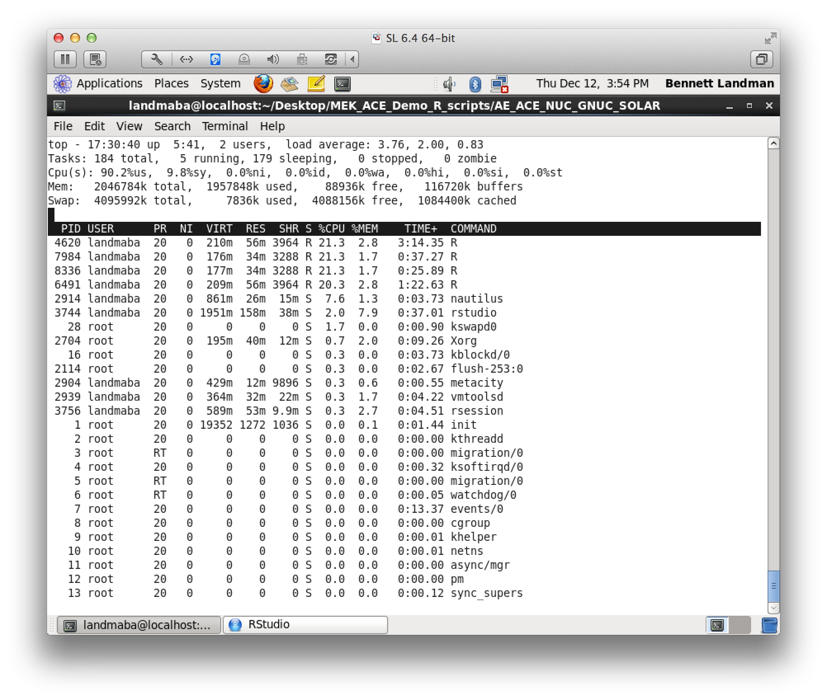
You can watch the jobs run with “top”

Slide 39
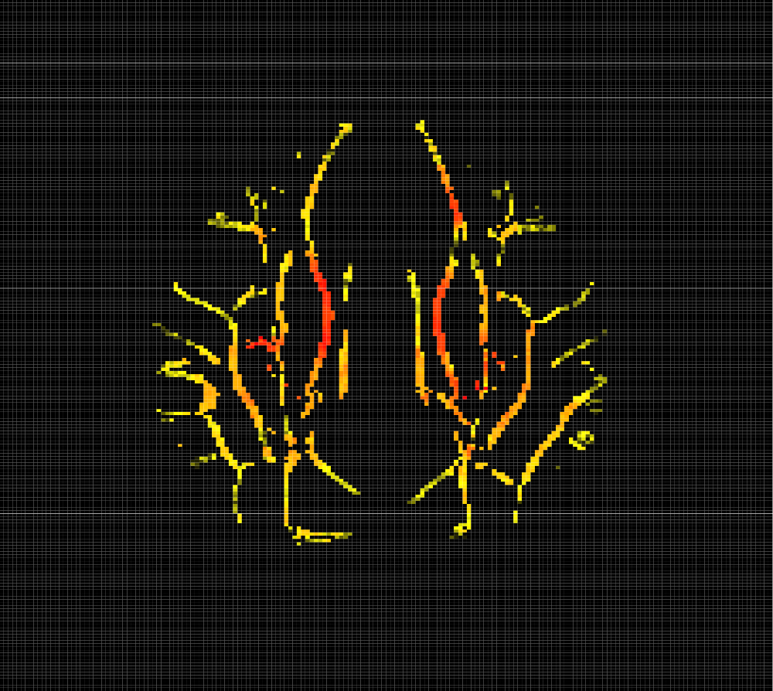
The OpenMX R files general script files for SOLAR. In production, we submit these to a cluster for quick processing.

Slide 40
Create a partition to store the output data
The simulations in “R_Scripts” create 11.5M files in 27GB. This causes problems for “ext”, “fat”, and “ntfs” file systems. We strongly recommend using zfs to create a file system that can handle many small files. We created a second 32 GB disk and attached it to our VM.

Slide 41
To install zfs
Using: http://zfsonlinux.org/epel.html
sudo yum localinstall --nogpgcheck http://archive.zfsonlinux.org/epel/zfs-release-1-3.el6.noarch.rpm
sudo yum install zfs sudo yum install zfs

Slide 42
To initialize zfs to the 2nd virtual hard drive
zfs create –f data /dev/sdb1
Then, zfs will automatically mount the data to /data
[landmaba@localhost twins]$ df -h
Filesystem Size Used Avail Use% Mounted on
/dev/mapper/VolGroup-lv_root 26G 6.3G 18G 27% /
tmpfs 935M 376K 935M 1% /dev/shm
/dev/sda1 485M 63M 398M 14% /boot
data 32G 27G 4.4G 87% /data

Slide 43
That’s it.
You can run the R scripts in the R_Scripts and LiveDemo desktop folder on the Virtual Machine.
Or, you can download the R scripts from the documents area.
For questions or concerns, please contact bennett.landman@vanderbilt.edu

